Slide 1
Analysis of the Worldwide Transit Systems
By: Angelina, Brian, MaiDao and Matt
University of Minnesota Visualization and Data

Slide 2
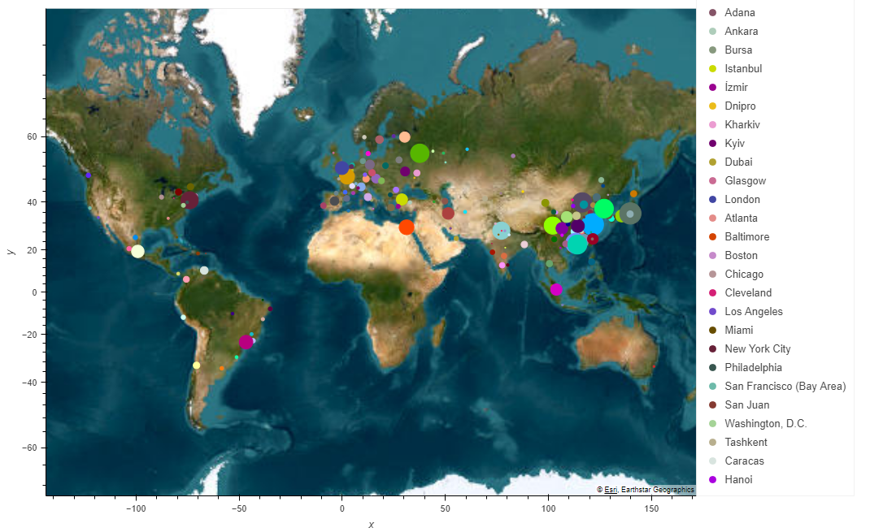
Metro-Systems-Worldwide | Kaggle

Slide 3
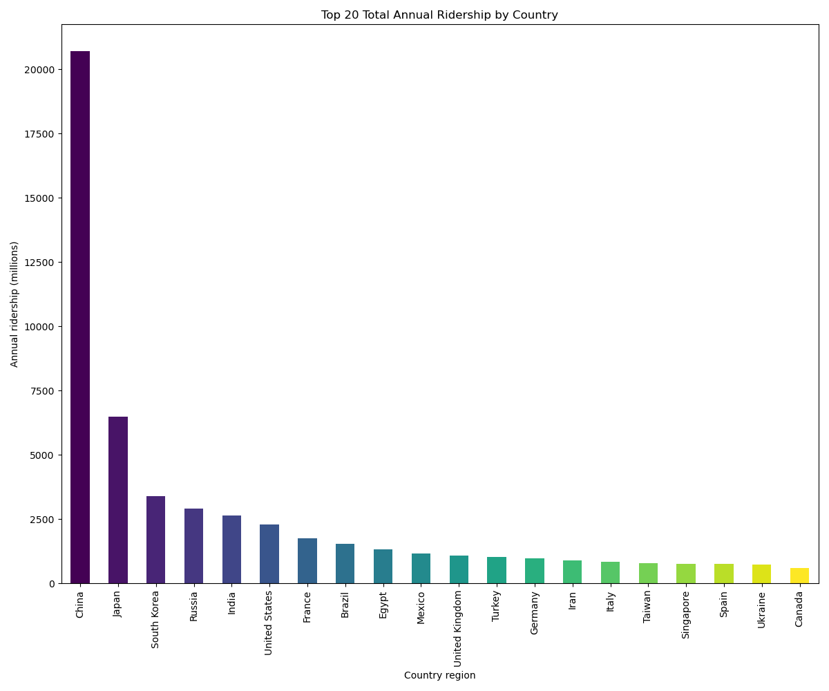

Slide 4
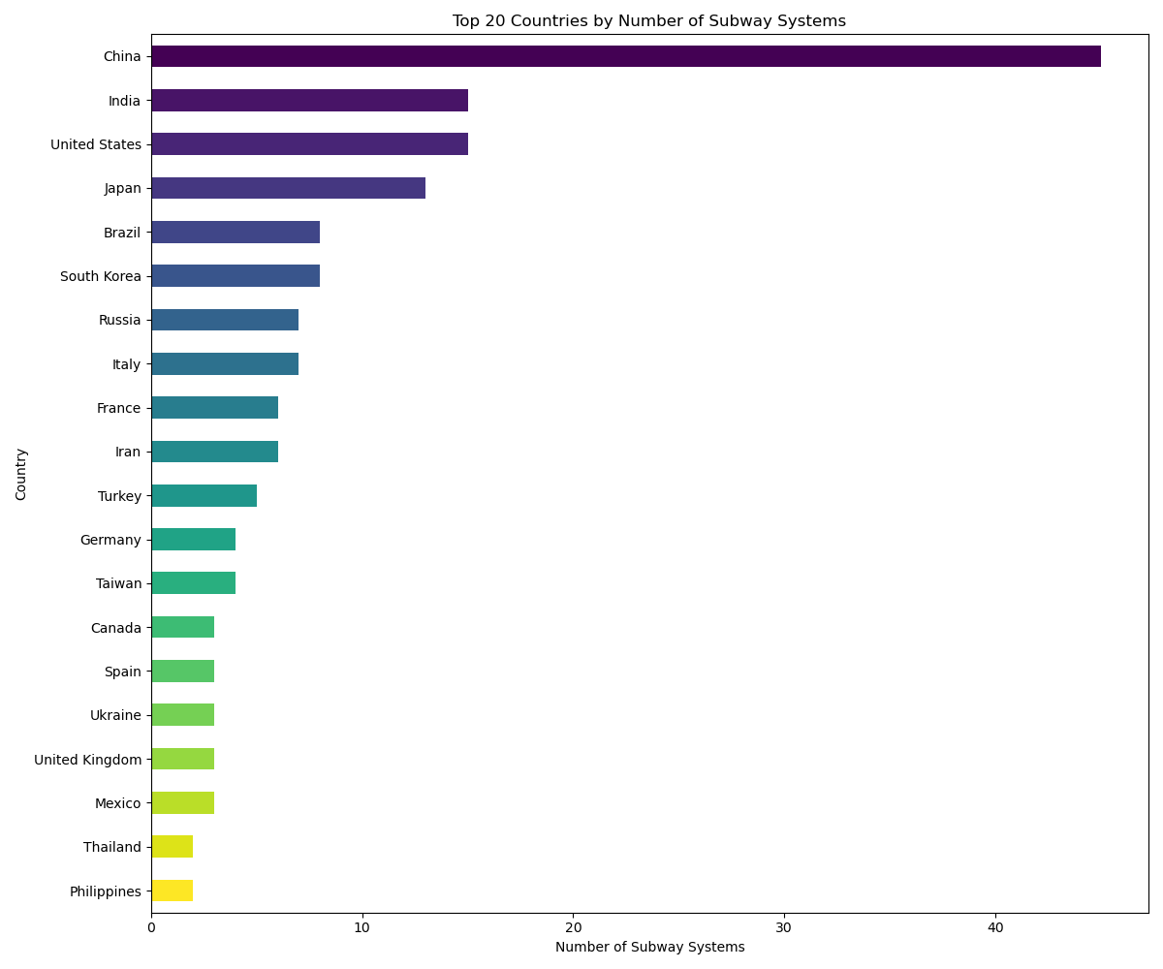
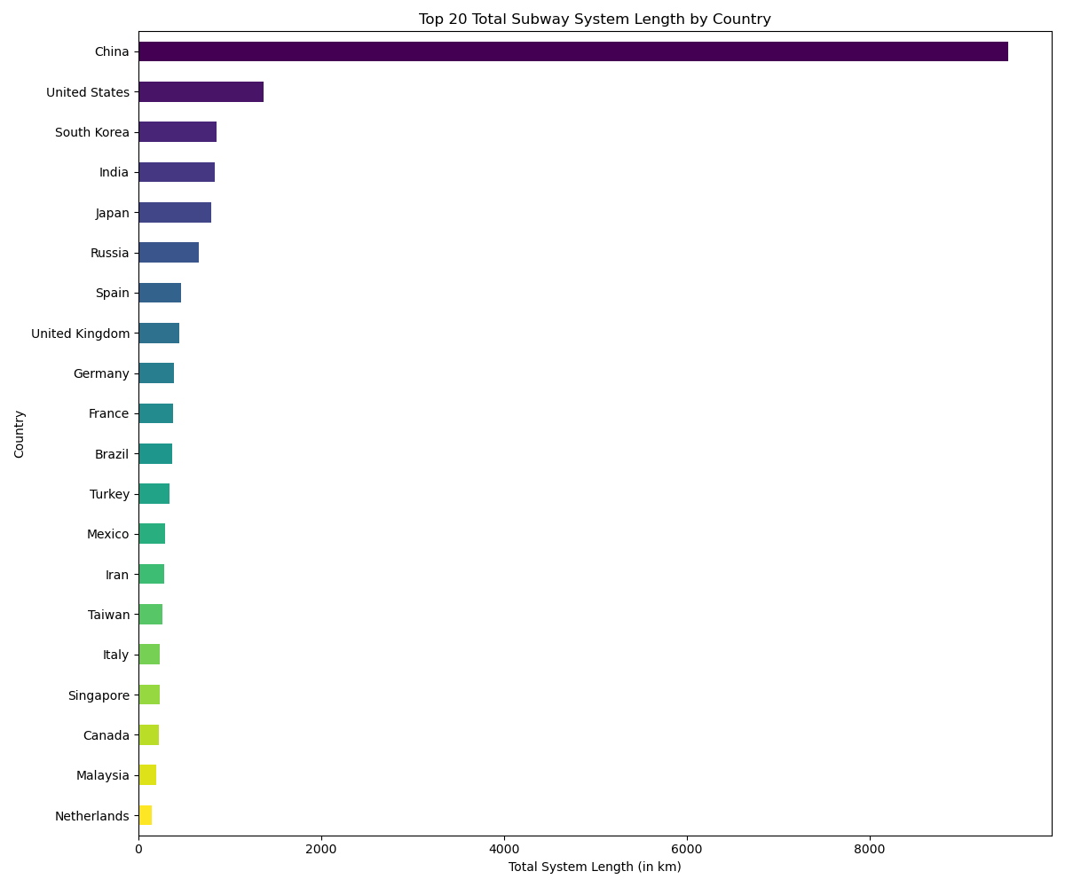

Slide 5
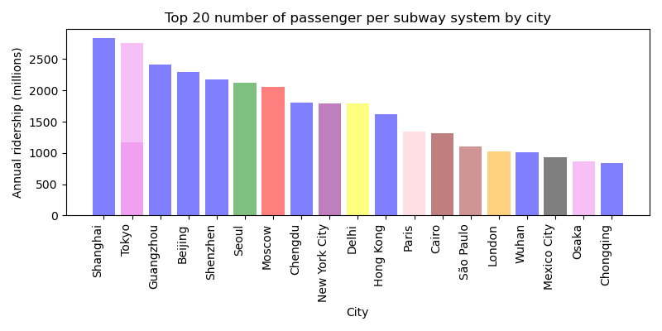

Slide 6
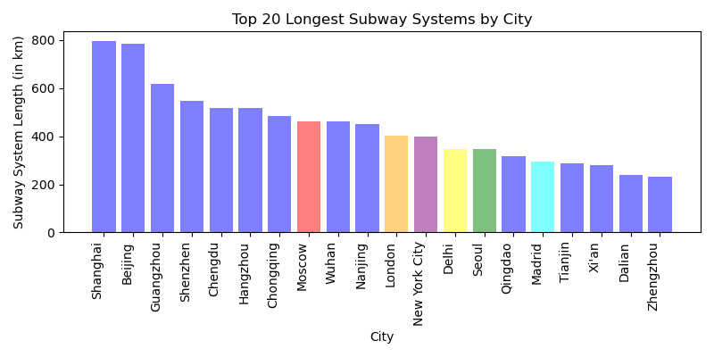

Slide 7
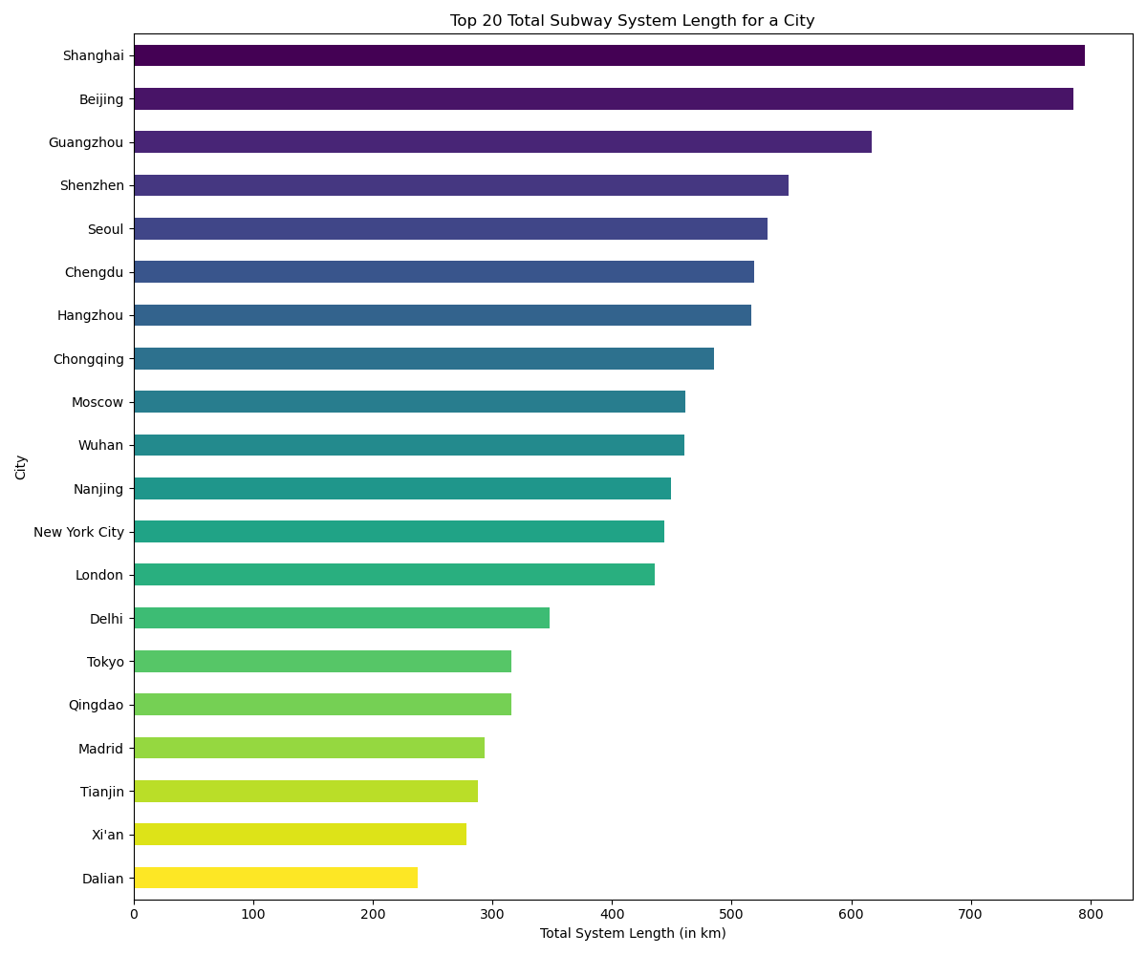

Slide 8
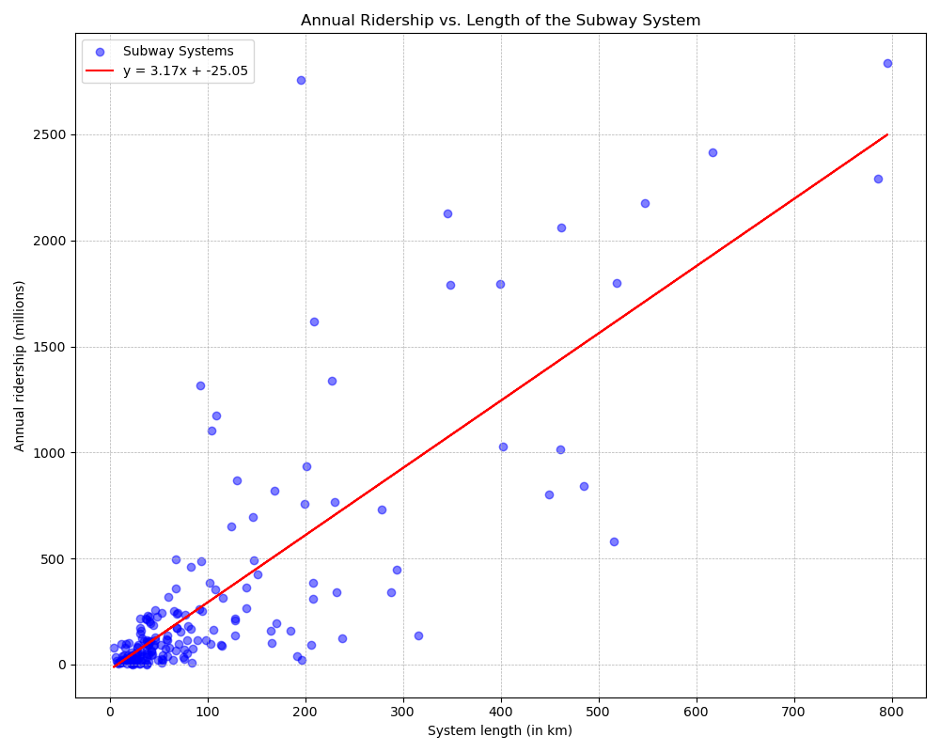
The R²-value is: 0.65

Slide 9
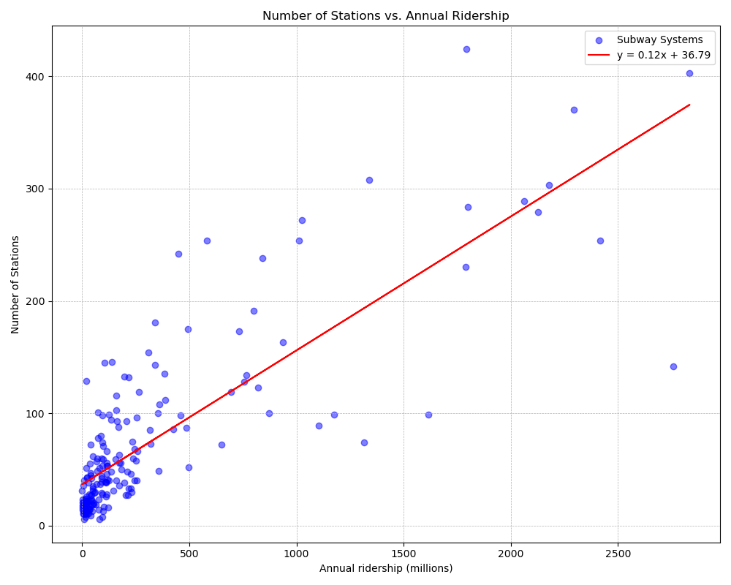
The R²-value is: 0.67

Slide 10
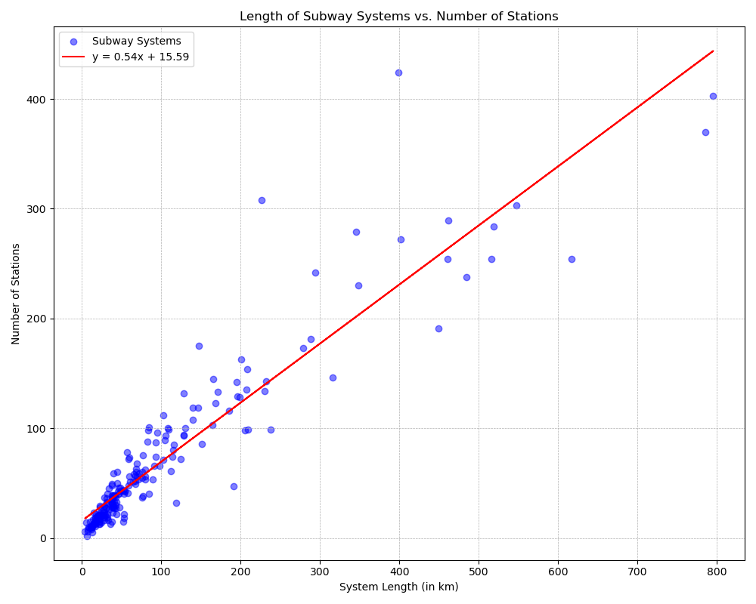
The R²-value is: 0.87

Slide 11
Conclusions
Our analysis confirms that while many regions around the world have recognized the importance of robust transit systems and have invested in them, there are significant gaps, especially in Africa and India. These areas require urgent attention to enhance their transit capacities.
Analysis of current subway systems identifies several relationships that should be considered in the design of future subways. For example, the number of subway stations per distance of subway system.

